Slide 1
Heroes and Role Models for My Child and My Family
Gary Shulman, MS. Ed.
garyshulman.jimdo.com
shulman.gary@yahoo.com

Slide 2
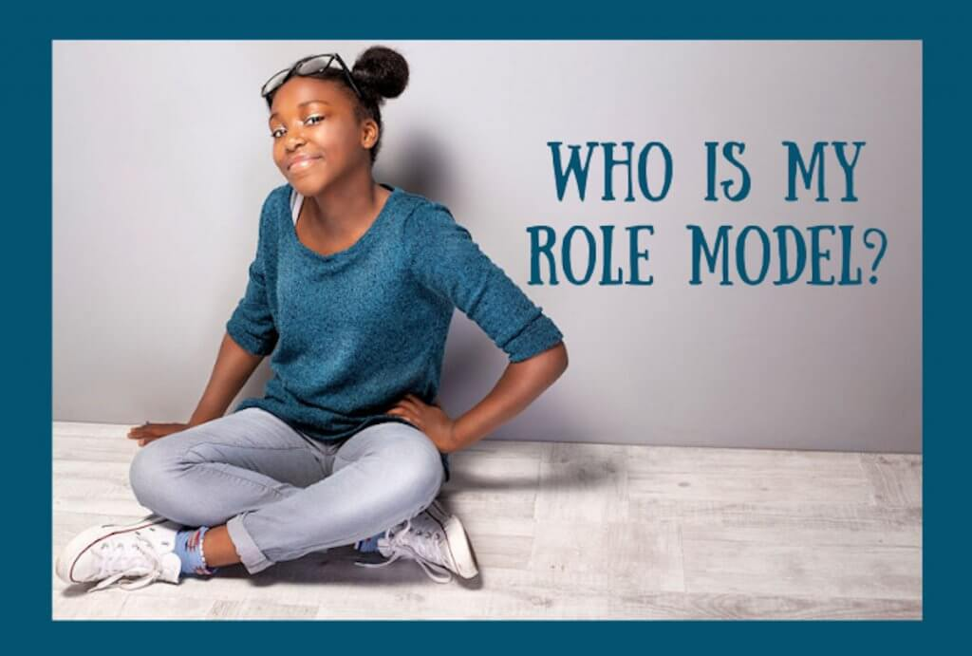
Who let’s you know that you are “good enough” just being who you are?

Slide 3
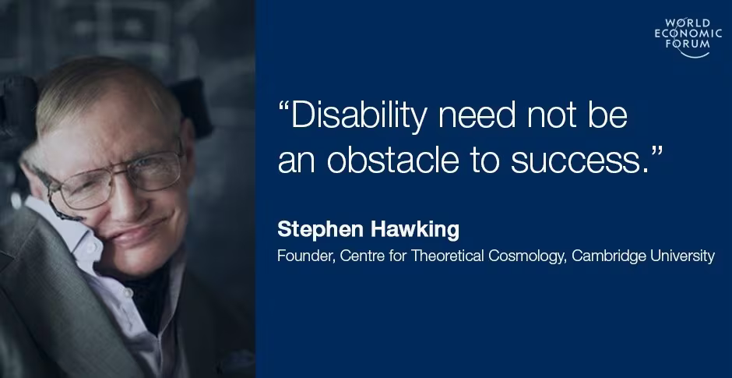
Why is it important for children, teens and young adults with disabilities to know about people with their disability who followed their passions and found success?

Slide 4
See it to be it: ??????
If you never see yourself reflected in the media, what is the message?
It gives hope when you see someone with a disability in a positive light-MUST teach this in school as just part of our history
Other reasons it is important to have heroes and role models like you or your child?

Slide 5
Let’s Explore Heroes and Role Models with Disabilities
Can you think of anyone that you admire who happens to have a disability?

Slide 6
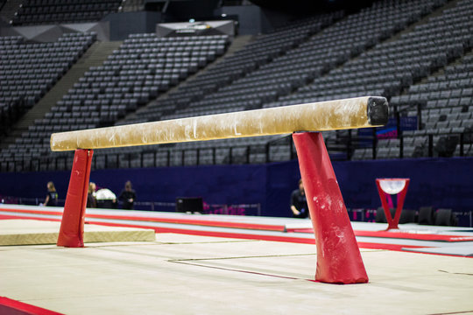
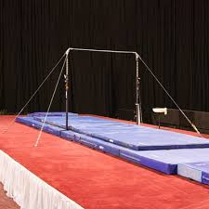
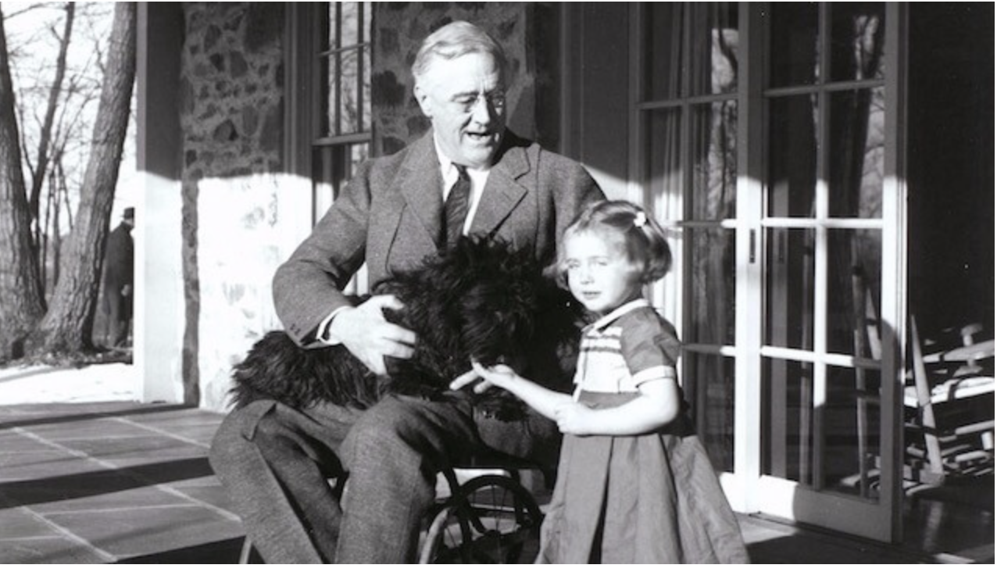
Hint!

Slide 7
Short attention span
Forgetful or losing things
Difficulty listening to or carrying out instructions
Difficulty organizing tasks
Fidgeting
Excessive talking
Difficulty taking turns
Interrupting conversations

Slide 8
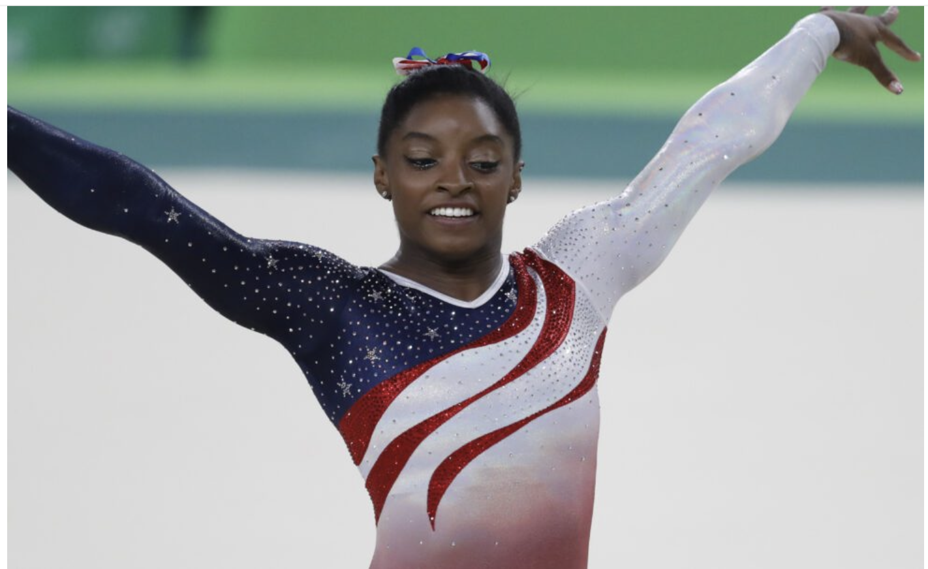
Simone Biles has ADHD
No-it doesn’t mean your child will necessarily be an Olympic champion but wouldn’t it be great to share this with your child who also has ADHD?

Slide 9
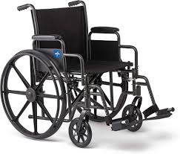
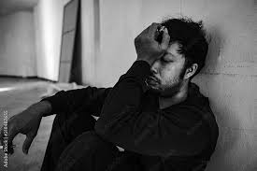
Can you name 2 Presidents with disabilities?
Hints!

Slide 10
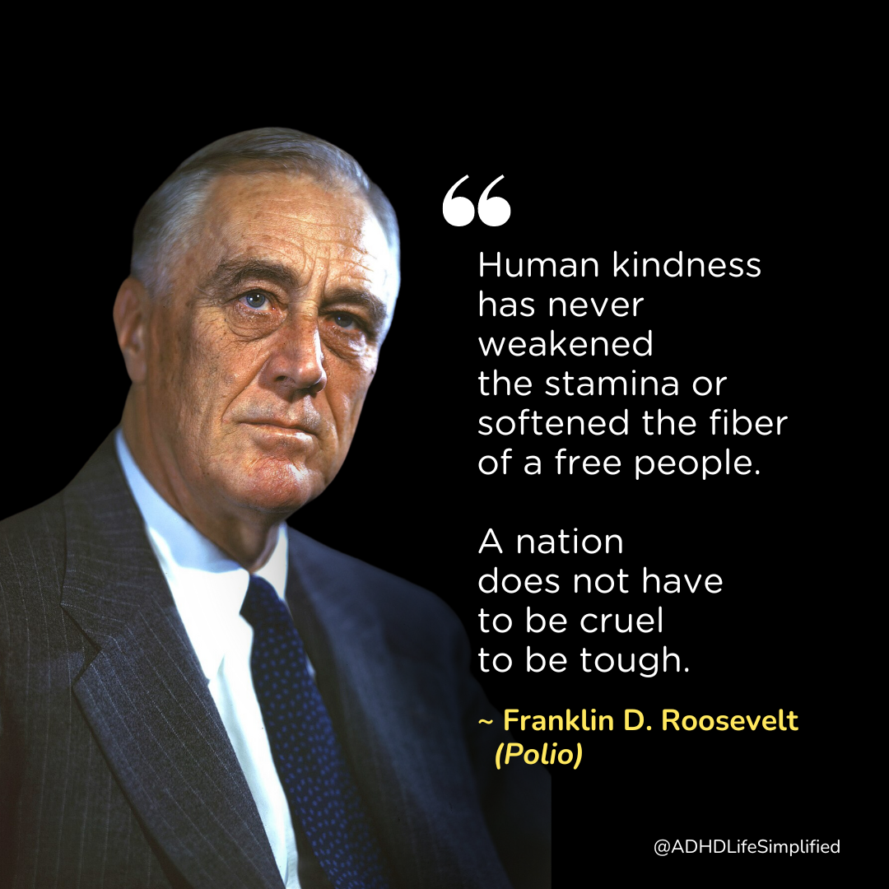
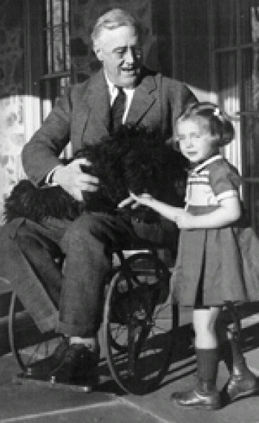

Slide 11
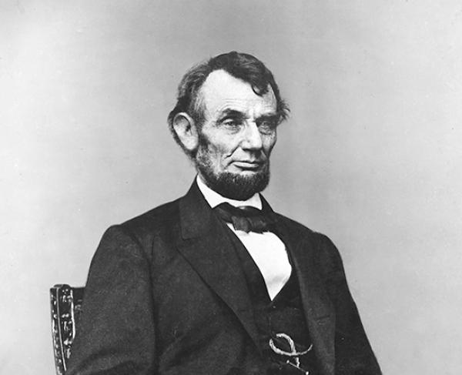
Abraham Lincoln: Bouts of severe depression throughout his life

Slide 12

1 in 31 Children in the USA are born With Autism
Can you think of famous people with Autism?

Slide 13
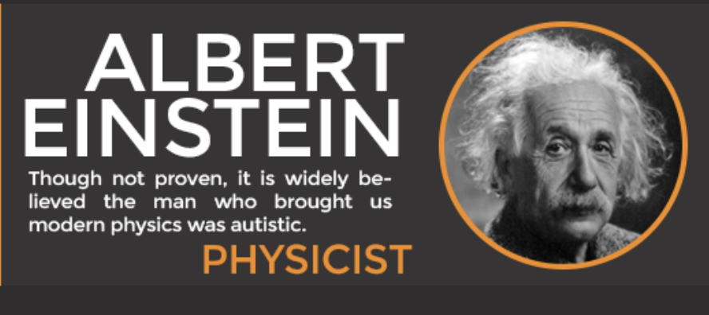
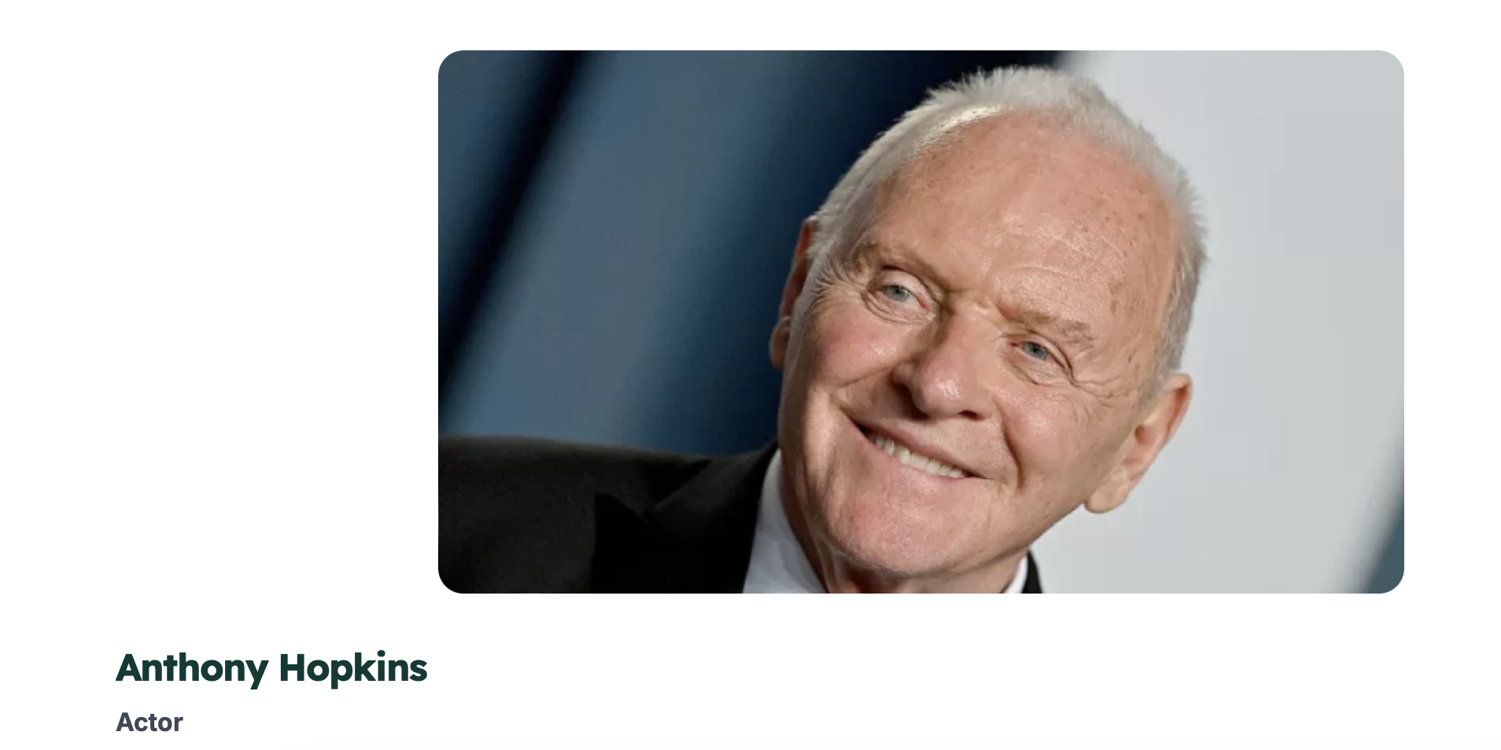
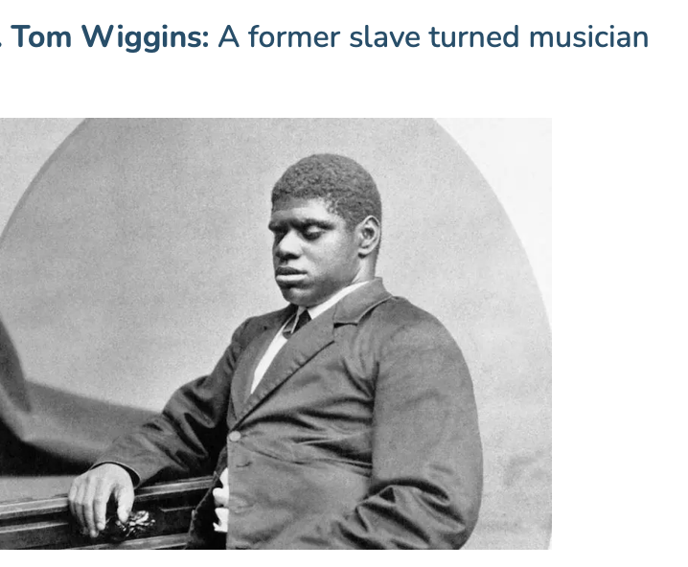
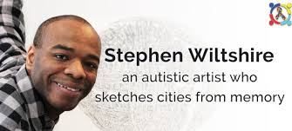
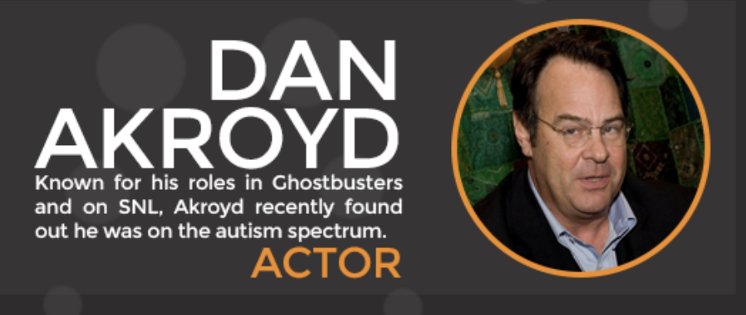
The first black person to perform in the White House-Autistic and Blind
Academy Award Winning Actor

Slide 14
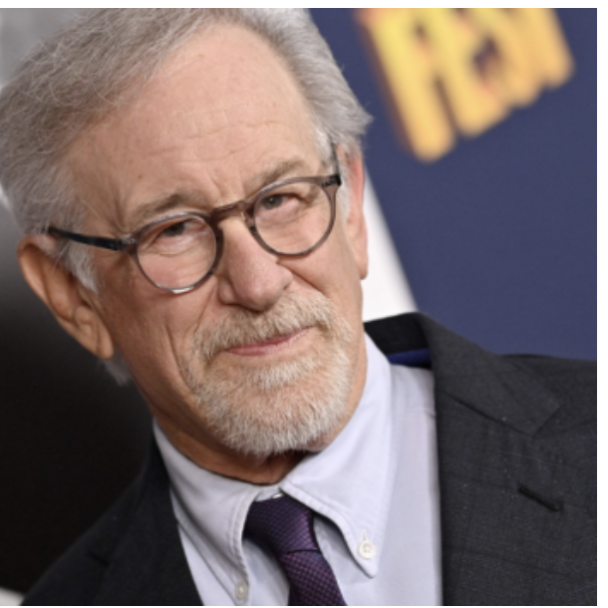
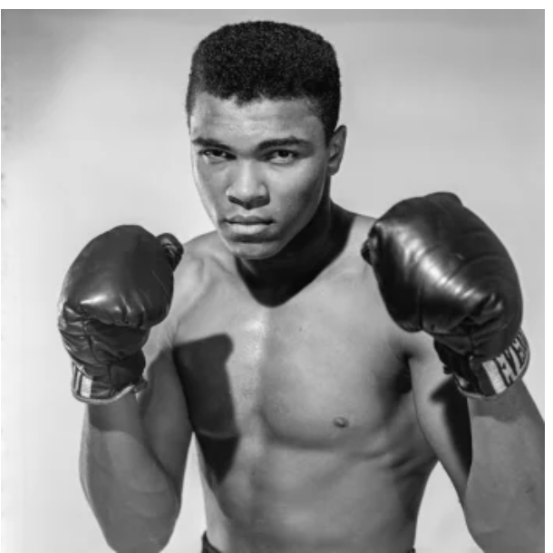
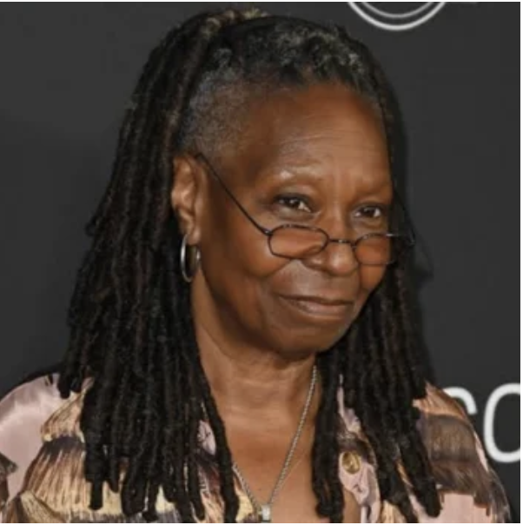
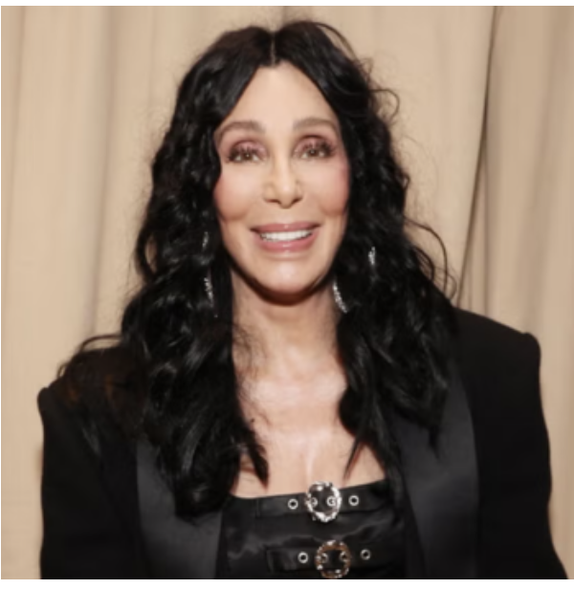
Steven Spielberg
Muhammad Ali
What do they all have in common?
Whoopi Goldberg
Cher

Slide 15

They all have learning disabilities

Slide 16
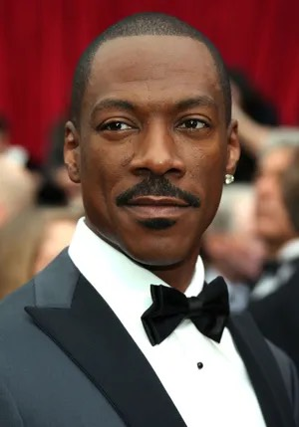
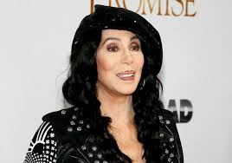
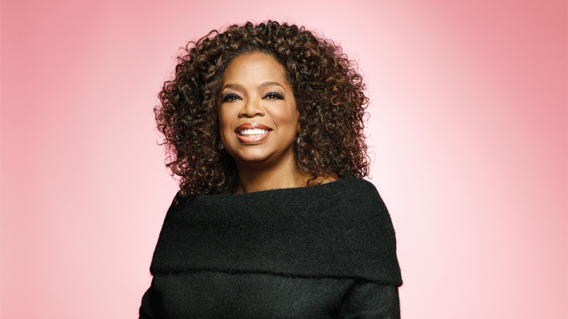
What do they have in common?
Eddie Murphy
Cher
Oprah Winfrey

Slide 17
They were all in the foster care system!
There are many other famous people who were in the foster care system and became very successful in life
Foster Focus Magazine’s Listing:
https://www.fosterfocusmag.com/famous-foster-kids
Mentor Foster Care’s Listing
https://blog.sevitahealth.com/famous-black-people-in-foster-care
Reader’s Digest Listing
https://www.rd.com/list/famous-people-you-didnt-know-were-foster-kids-or-foster-parents/
Time Out Listing
https://www.timeoutfostering.co.uk/celebrities-who-started-life-in-foster-care/

Slide 18

A hero does not have to be a famous person!!!
Who are other heroes and role models for the children?

Slide 19

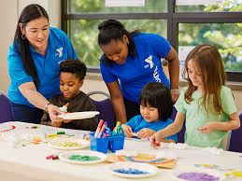
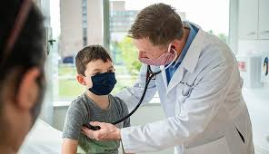

Recreation Center Staff
Occupational and Physical Therapists
Doctors
Teachers

Slide 20
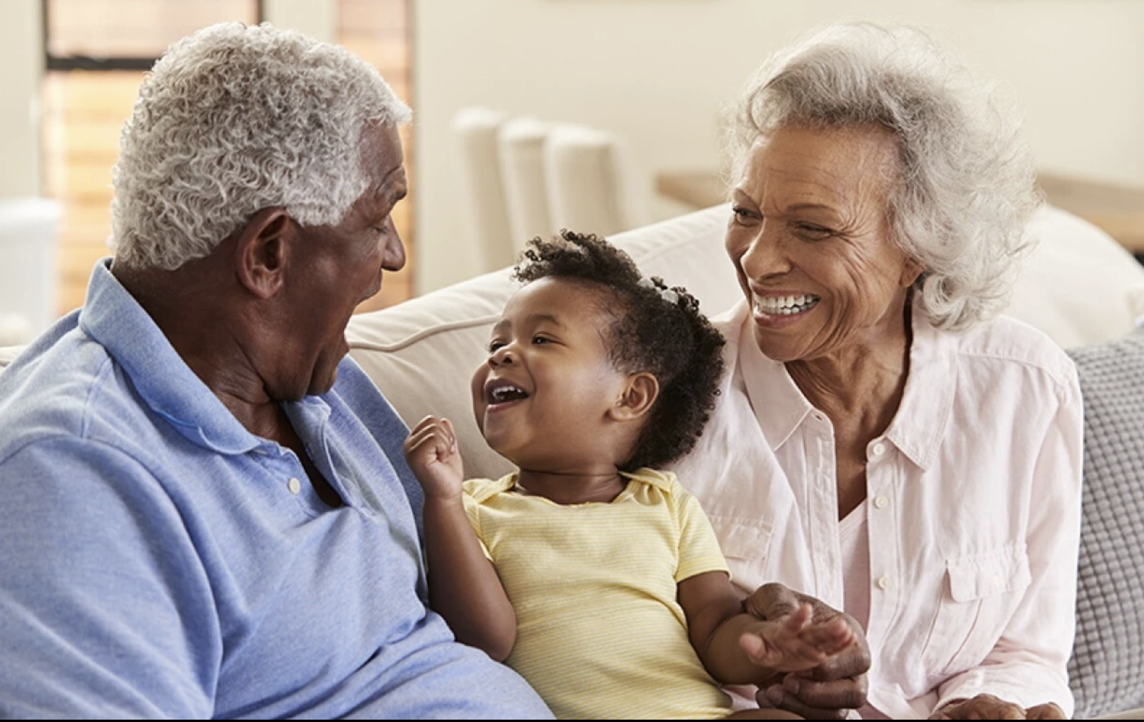
Grandparents

Slide 21

YOU!!!!! 100%!!!

Slide 22
The MOST important hero
?

Slide 23
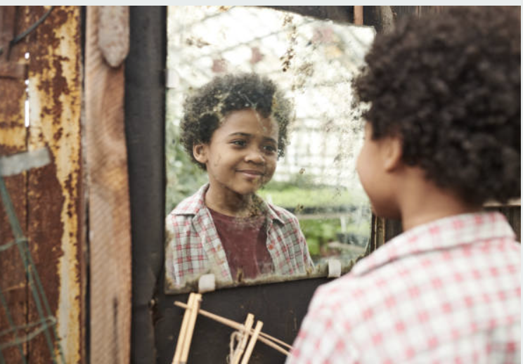
You are my hero! Look how far you have come-BRAVO!
At the end of the day, by you making choices that support helping your child be the best person possible, that child can become their own hero.

Slide 24
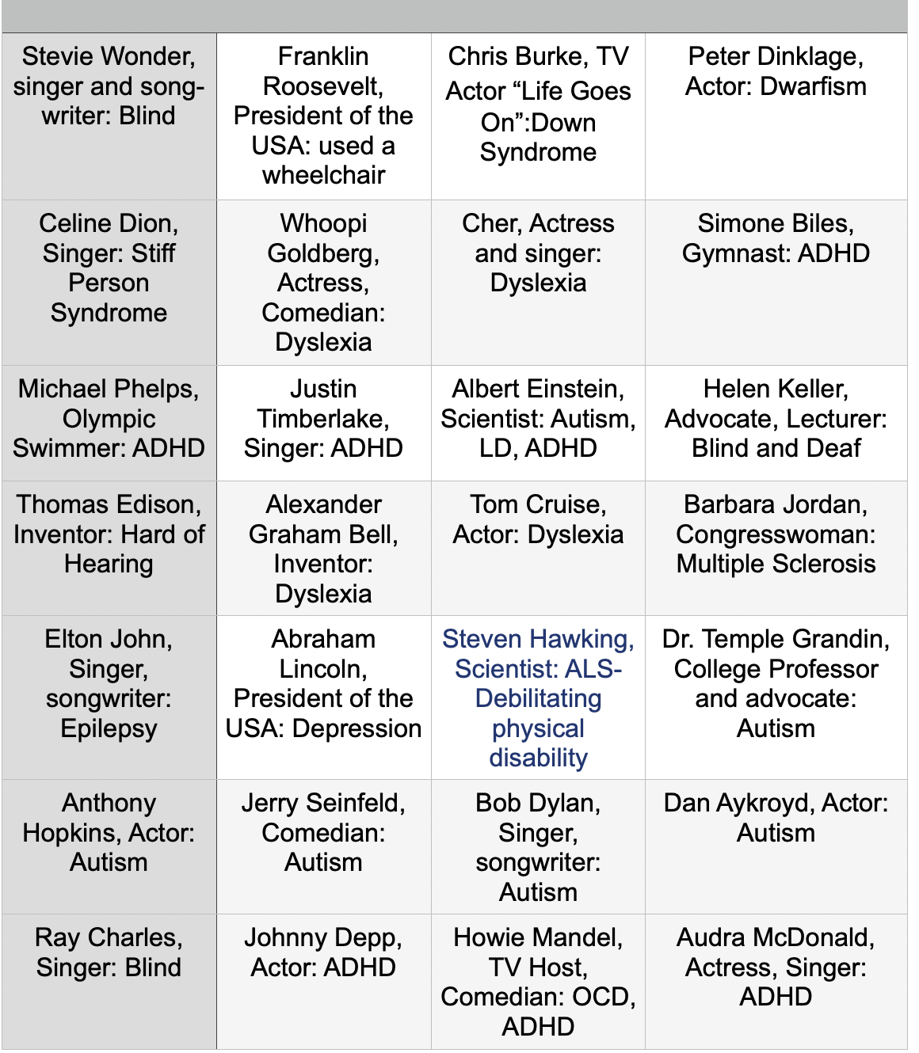
Famous People with Disabilities

Slide 25
Bravo Dear Foster Parents
Gary Shulman, MS. Ed.
Feb. 19, 2025
You take into your lives the most vulnerable children
Trauma has already assaulted their soul
You certainly aren’t doing it for the financial gains
You do it to make them feel whole
Their difficult, traumatic journey in life
Has been a wild roller coaster ride for sure
Until you take them into your haven of love
And offer your understanding pristine and pure
Not saying you know exactly what to say or do
Disabilities often come along with the child
Sometimes you just feel like giving it all up
When that child seems uncontrollably wild
So you train, you learn you improve with each day
Some days bad, some a miraculous success
You learn just who this unique child is
And realize that your life that child did bless
So this is just a pat on the back
A recognition of your passion and dedication
Thank you for all that you do for these children
For every child deserves a life of celebration

